Slide 1
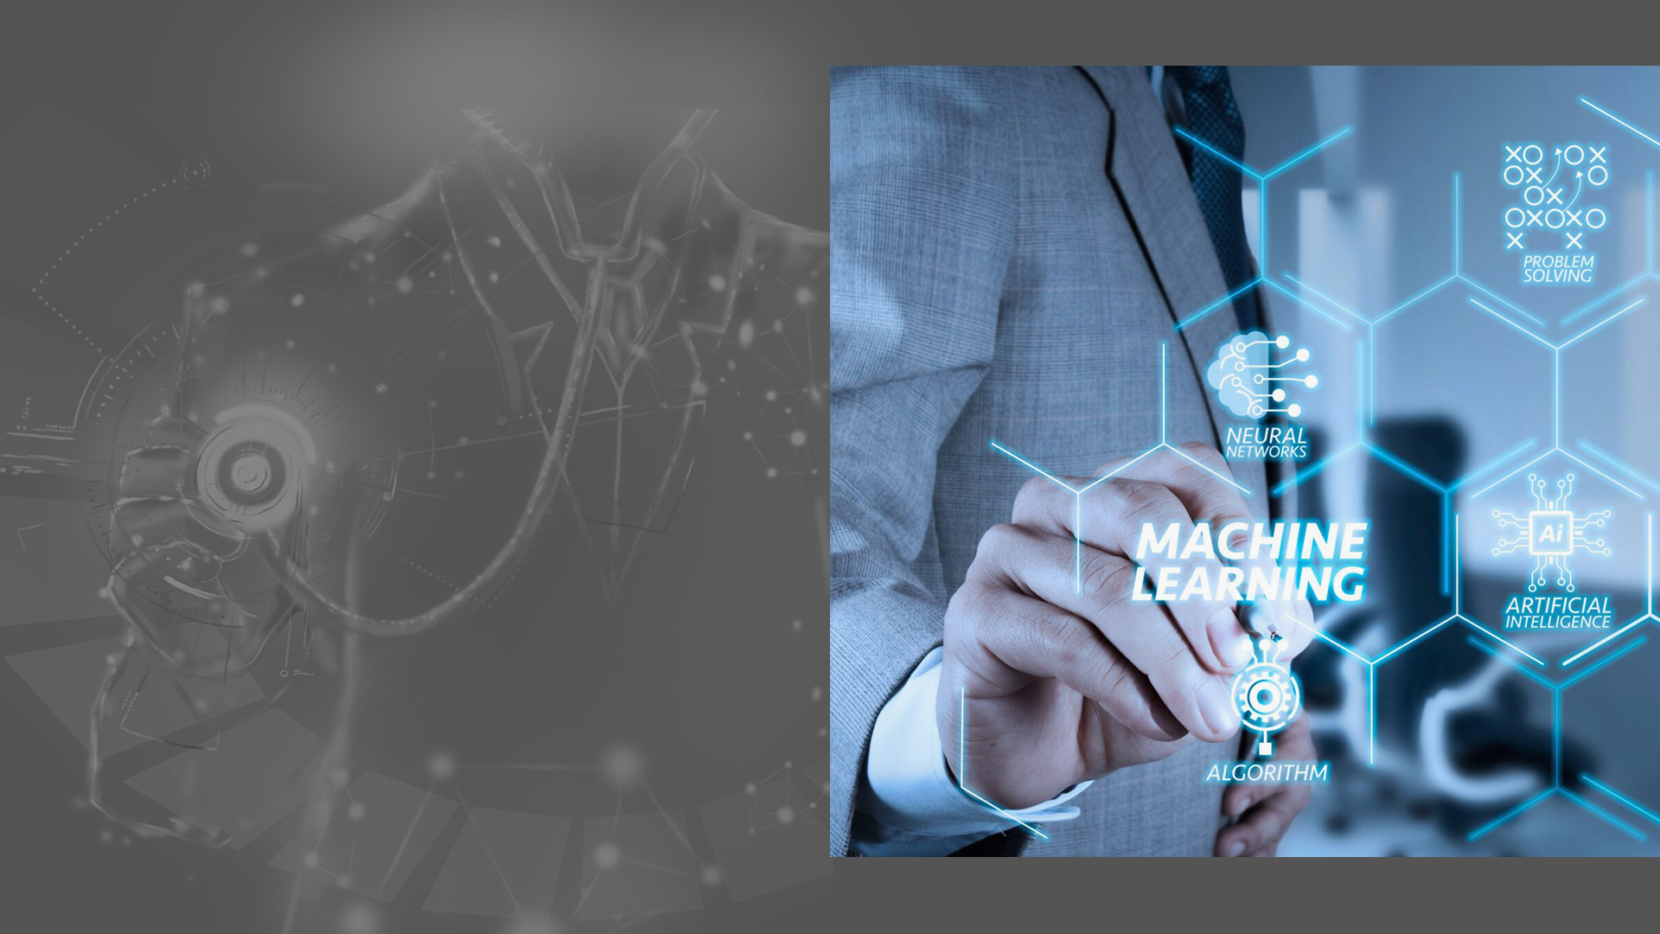
Statistical Machine Learning Approaches to Liver Disease Prediction
PRESENTED By,
Robin Biju
S4 MCA
Roll NO : MCK20MCA-2037
GUIDED By,
Deepa Thomas
Assistant Professor
Department of CSE

Slide 2
TABLE OF CONTENTS
OBJECTIVE
INTRODUCTION
LITERATURE REVIEW
EXISTING SYSTEM
PROPOSED SYSTEM
MODULES
ALGORITHM
SYSTEM ARCHITECTURE
CONCLUSION
REFRENCES
SCREENSHOTS
GRAPH ANALYSIS

Slide 3
OBJECTIVE
This project helps to predict liver disease using the random forest algorithm.

Slide 4
INTRODUCTION
Patients with Liver disease have been continuously increasing because of excessive consumption of alcohol, inhale of harmful gases, intake of contaminated food, pickles and drugs.
This dataset was used to evaluate prediction algorithms in an effort to reduce burden on doctors.
The use of artificial intelligence and machine learning in combination with clinical findings has further improved disease detection.
Machine learning (ML) algorithms can be utilized to validate and help researchers to make potential new decisions.
The purpose of this study was to extract significant predictors for liver disease from the medical analysis of humans using ML algorithms.

Slide 5
LITERATURE REVIEW
Software-based Prediction of Liver Disease with Feature Selection and Classification Techniques. [JagdeepSingh 1970–1980]
Today’s health care is very important aspect for every human, so there is a need to provide medical services that are easily available to everyone.
In this paper, the main focus is to predict the liver disease based on a software engineering approach using classification and feature selection technique.
The implementation of proposed work is done on Indian Liver Patient Dataset (ILPD) from the University of California, Irvine database.
The different attributes like age, direct bilirubin, gender, total bilirubin, Alkphos, sgpt, albumin, globulin ratio and sgot etc, of the liver patient dataset, are used to predict the liver diseases risk level.
The various classification algorithms such as Logistic Regression, Sequential minimal optimizaton and k-nearest neighbor are implemented on the Liver Patient dataset to find the accuracy.

Slide 6
Biochemical Evaluation of Patients of Alcoholic Liver Disease and Non-alcoholic Liver Disease.[PRASAD.P.TORKADI 1979–1983]
The main disadvantage of this system is that the KNN algorithm classifies the data in accordance with the majority in the dataset, this algorithm predicts the result, but the accuracy is very less.
Alcoholic liver disease (ALD) is due to excessive alcohol intake for long duration.
Distinguishing ALD from non-ALD (non-alcoholic steatohepatitis, hepatitis of viral origin) is difficult as patient may deny alcohol abuse.
Accurate diagnosis is important as management of ALD differs from non-ALD patients.
The aim of this system was (1) To evaluate the patients of ALD and non-ALD by biochemical parameters compared to controls, (2) To assess whether these parameters can differentiate ALD from non-ALD.

Slide 7
Study was carried out on 50 patients of ALD in group I and 35 patients of NASH (non-alcoholic steatohepatitis) and acute viral hepatitis each in group II.
Our study concludes that ALD patients can be differentiated from NASH and acute viral hepatitis with certainty by measuring serum AST/ALT ratio, GGT and ALP.
These biochemical parameters may help clinicians to support the diagnosis of ALD and non-ALD.

Slide 8
Liver Disease Prediction using Naïve Bayes Algorithms.[Dr. S. Vijayarani 1816–1820]
In recent years in healthcare sectors, data mining became an ease of use for disease prediction.
Data mining is the process of dredge up information from the massive datasets or warehouse or other repositories.
It is a very challenging task to the researchers to predict the diseases from the voluminous medical databases.
To overcome this issue the researchers use data mining techniques such as classification, clustering, association rules and so on.
The main objective of this research work is to predict liver diseases using classification algorithms.

Slide 9
The algorithms used in this work are Naïve Bayes.
These classifier algorithms are compared based on the performance factors i.e. classification accuracy and execution time.

Slide 10
Evaluation of Abnormal Liver Tests[Tinsay A. Woreta 2014]
The use of serum biochemical tests plays an important role in the diagnosis and management of liver diseases.
The routine use of such tests has led to the increased detection of liver diseases in otherwise asymptomatic patients, often providing the first clue of the presence of liver pathology.
Such laboratory tests, in addition to a careful history, physical examination, and imaging tests, can help clinicians determine the cause of liver disease in most cases.
Traditionally, liver injury has been characterized as primarily hepatocellular versus cholestatic based on the degree of elevation of aminotransferases compared with Alkaline phosphatase.
Although such a distinction can help direct initial evaluation, there is often significant overlap in the presentation of various liver diseases, which often have a mixed pattern.

Slide 11
Improving healthcare operations management with machine learning [OlegS. Pianykh 2020]
Healthcare institutions need modern and powerful technology to provide high-quality, cost-effective care to patients.
However, despite the considerable progress in the computerization and digitization of medicine, efficient and robust management tools have yet to materialize.
One important reason for this is the extreme complexity and variability of healthcare operations, the needs of which have outgrown conventional management.
Machine learning algorithms, scalable and adaptive to complex patterns, may be particularly well suited to solving these.
The main goal of this work was to study this relationship using a person having disease or not.

Slide 12
EXISTING SYSTEM
From a detailed research about the topic, we came to know that there areas only two systems exists on the same domain.
The first system is fully manual. It can store the details of the patients and their medical reports. These are the main features of the first system.
Second system is more productive than first system. From a similar work paper, we came to know that the system is built using KNN algorithm. This algorithm predicts the result, but the accuracy is very less.
The main disadvantage of this system is that it classifies the data in accordance with the majority in the dataset. These are the main systems present in this domain.
So it would be very much useful to common people if we introduce a system which predicts if there is any chance for liver disease or not. And that system should be very accurate.

Slide 13
PROPOSED SYSTEM
Random Forest algorithm is used.
This System aims to impute missing data using the (Multiple Imputation by Chained Equation) MICE algorithm.
Compare among several statistical learning methods the ability to predict binary classifications of liver disease.
Obtain confusion matrices for comparing actual classes with predictive classes, compare several ML approaches to assess a better performance of liver disease diagnosis.
Evaluate receiver operating characteristic (ROC) curves for determining the diagnostic ability of binary classification of liver disease.
Here the patient can book an appointment to a specified doctor and the doctor can prescribe what test are needed to be done.
In this system it is used to predict the liver disease of a person based on the parameters such as total bilirubin, direct bilirubin, albumin, total protein etc.
Also in this system it can add the donor and recipient details who need the liver and blood during the transplantation time.

Slide 14
MODULES
Registration
Login
Hospital
Patient
Doctor
Liver Disease Prediction
Donor Details

Slide 15
ALGORITHM
Random forest is a Supervised Machine Learning Algorithm that is used widely in Classification and Regression problems.
It builds decision trees on different samples and takes their majority vote for classification and average in case of regression.

Slide 16
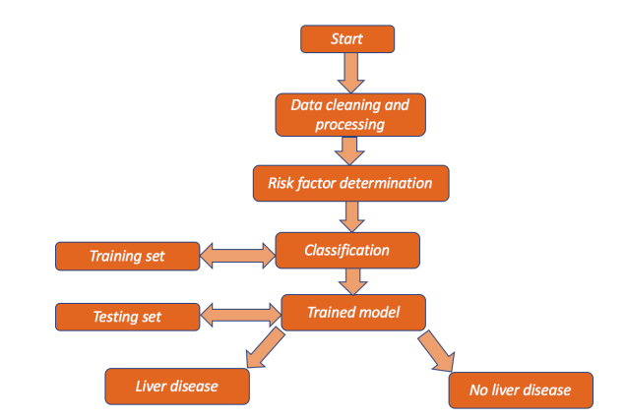
SYSTEM ARCHITECTURE

Slide 17
BLOOD DONATION
DATABASE
PATIENT
DOCTOR

Slide 18
CONCLUSION
Chronic liver disease is detected by clinicians who are well trained in identifying significant observations and classifying them as normal or abnormal using background information and other context clues.
ML algorithms can be trained to detect the possibility of liver disease in a similar way to assist healthcare workers.
Using the correlation of each variable with the risk of liver disease to train the model, ML methods were able to identify which blood donors were healthy and which had liver disease with high accuracy.
Application of the ML methods can help reduce the total burden of liver disease on public health worldwide by improving recognition of risk factors and diagnostic variables.
More importantly, for chronic liver disease, detecting liver disease at earlier stages or in hidden cases by ML could decrease liver-related mortality, transplants, and/or hospitalizations.

Slide 19

REFERENCES
Asrani, S.K.; Devarbhavi, H.; Eaton, J.; Kamath, P.S. “Burden of liver diseases in the world”. J. Hepatol. 2019.
Chalasani, N.; Younossi, Z.; Lavine, J.E.; Charlton, M.; Cusi, K.; Rinella, M.; Harrison, S.A.; Brunt, E.M.; Sanyal, A.J. “The diagnosis and management of nonalcoholic fatty liver disease: Practice guidance from the American Association for the Study of Liver Diseases”. Hepatology 2018.
Wang, Y.; Li, Y.; Wang, X.; Gacesa, R.; Zhang, J.; Zhou, L.; Wang, B. “Predicting Liver Disease Risk Using a Combination of Common Clinical Markers: A Screening Model from Routine Health Check-Up”. Dis. Markers 2020.

Slide 20

SCREENSHOTS
HOME PAGE

Slide 21
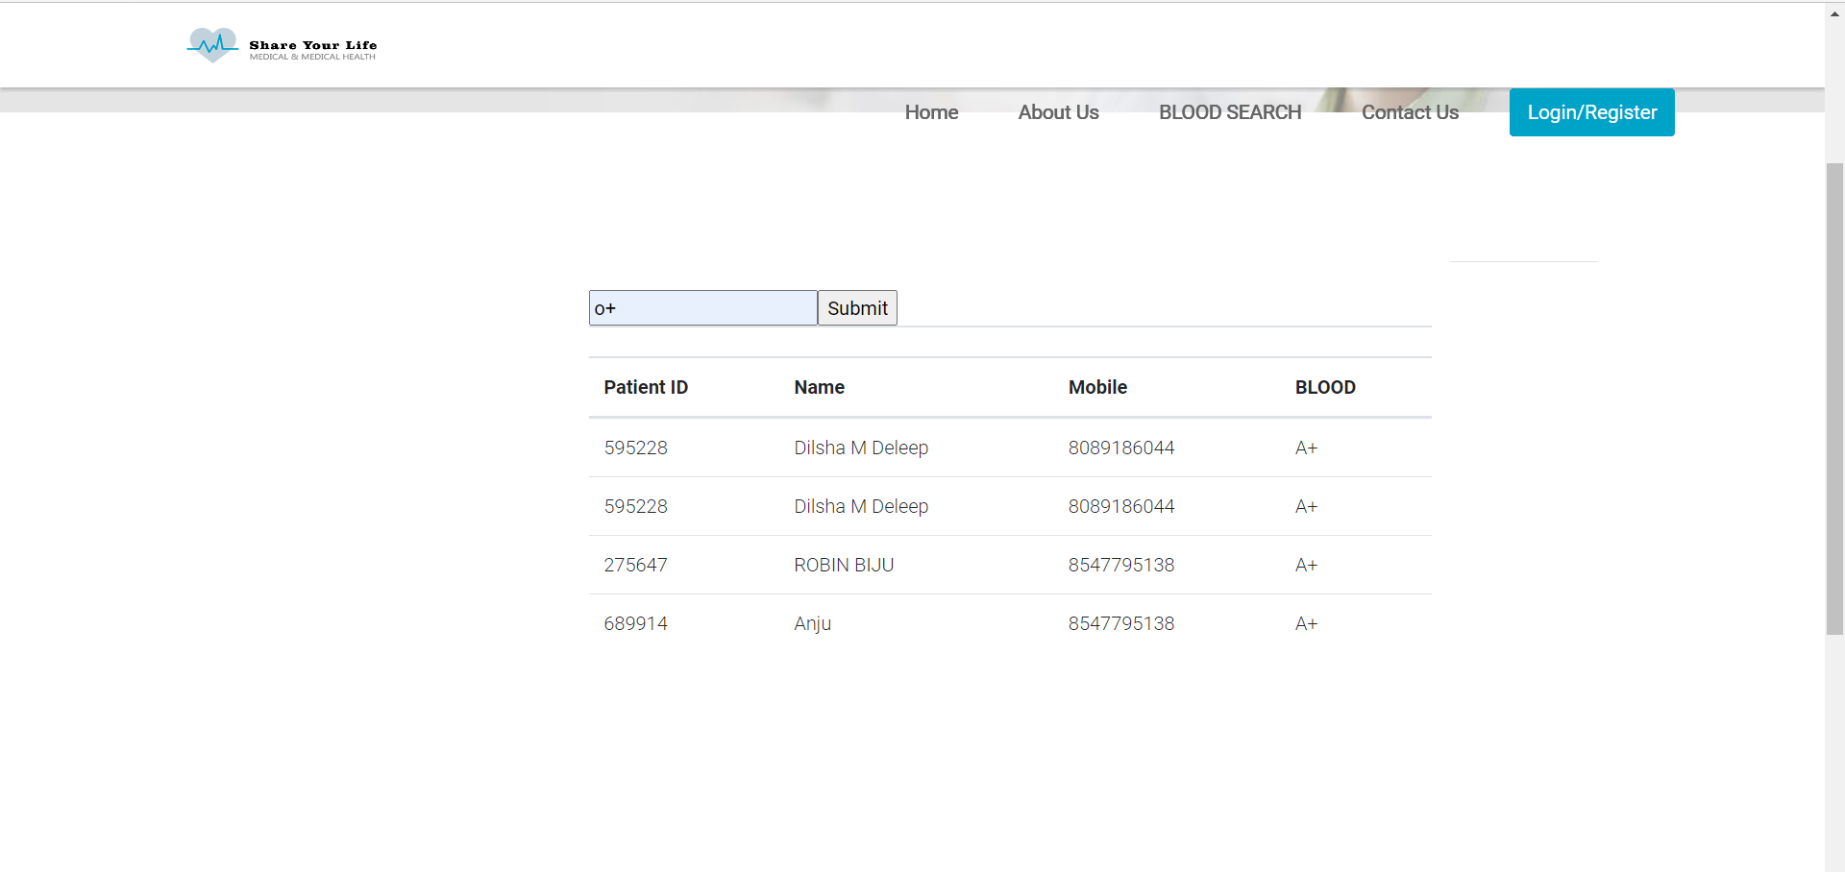
BLOOD SEARCH

Slide 22
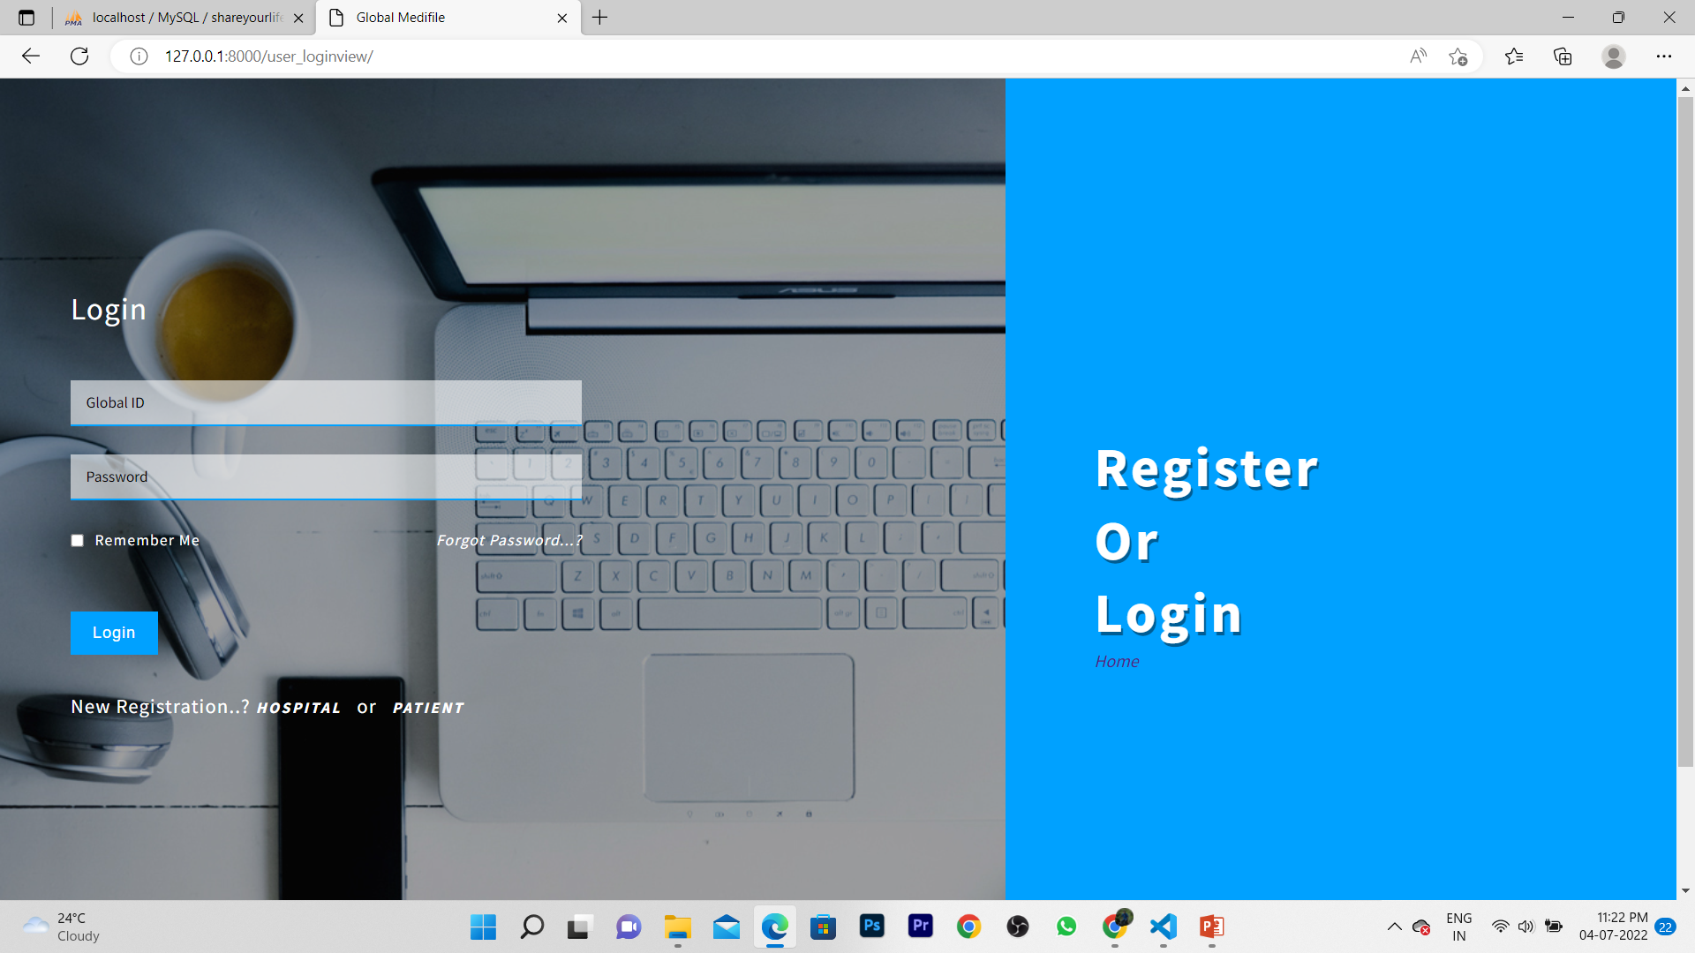
LOGIN & REGISTRATION

Slide 23
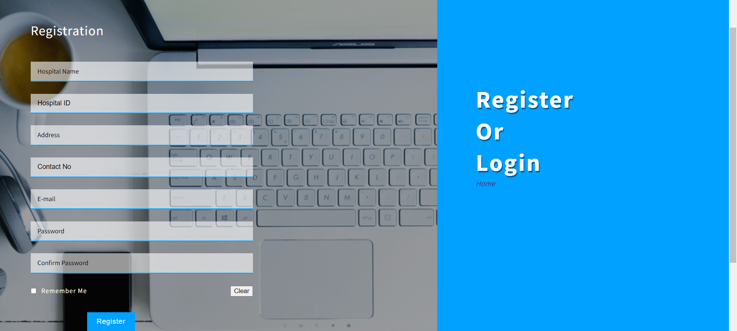
HOSPITAL REGISTRATION

Slide 24
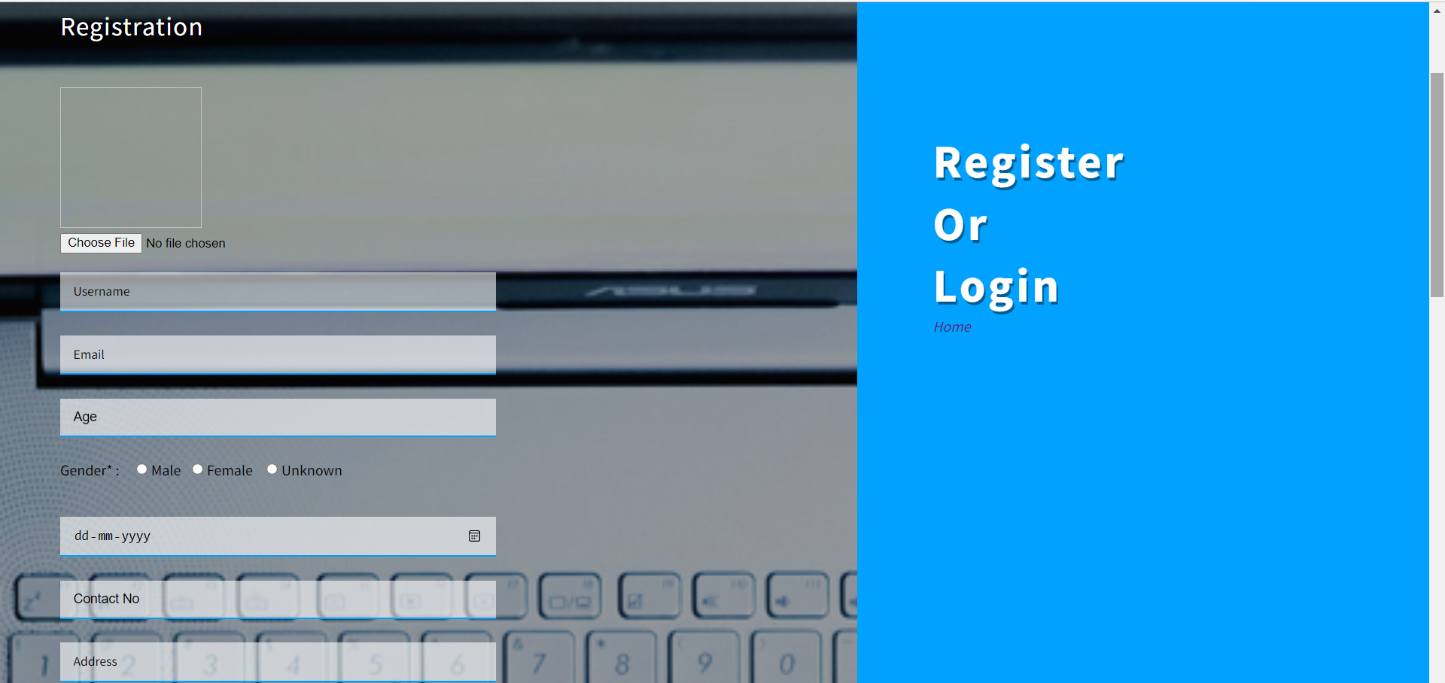
PATINET REGISTRATION

Slide 25
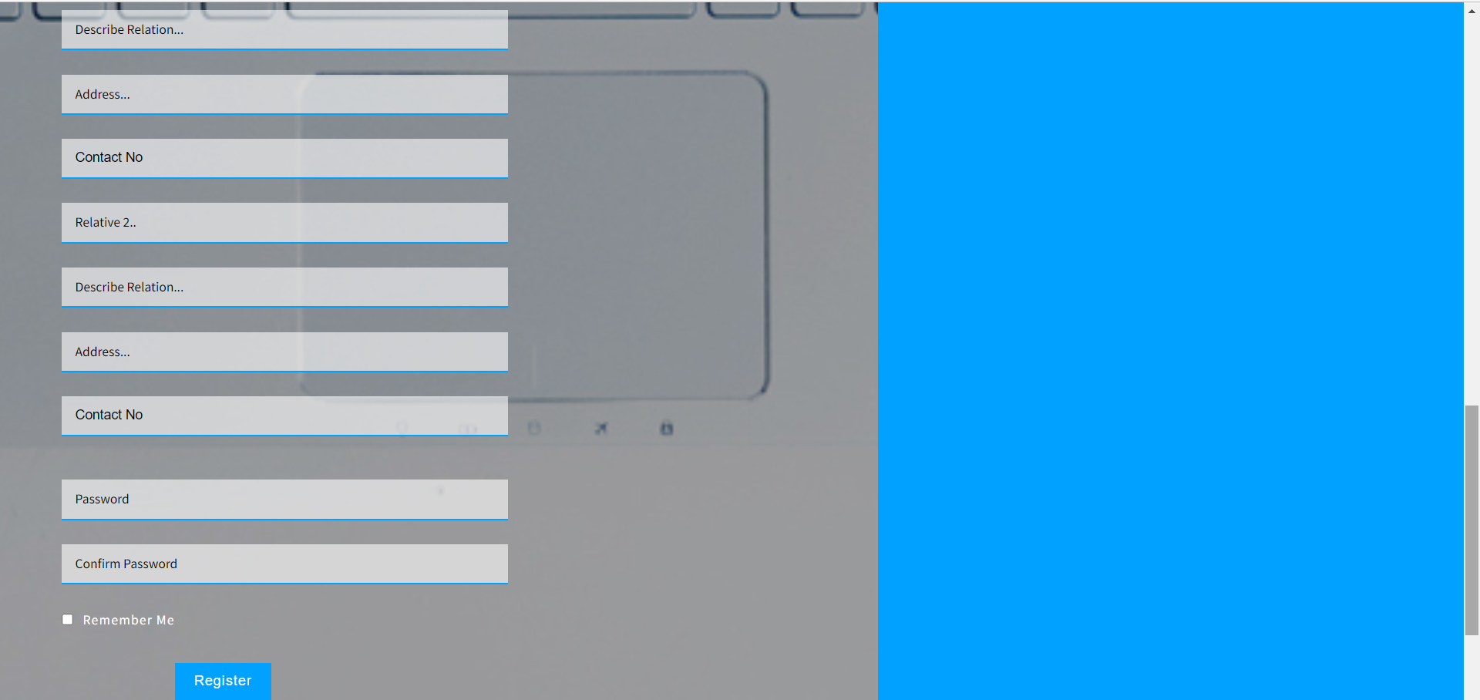

Slide 26
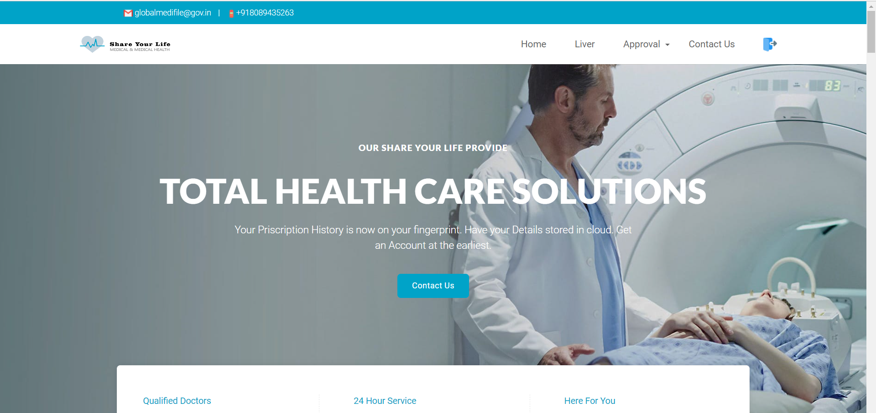
HOSPITAL HOME PAGE

Slide 27
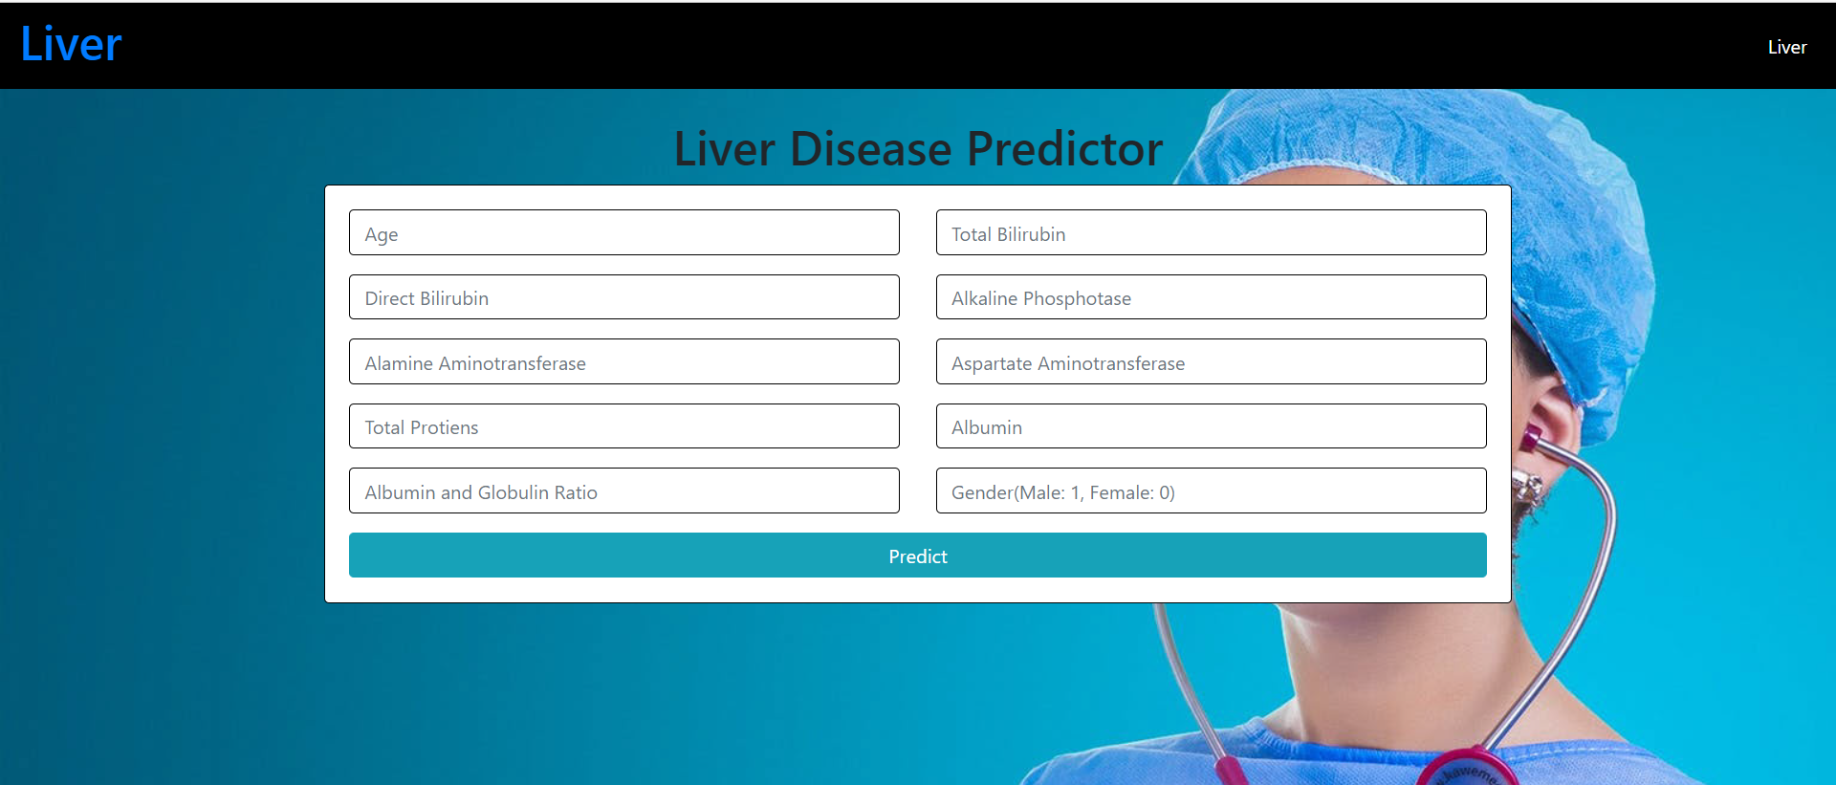
LIVER DISEASE PREDICTOR BY HOSPITAL

Slide 28
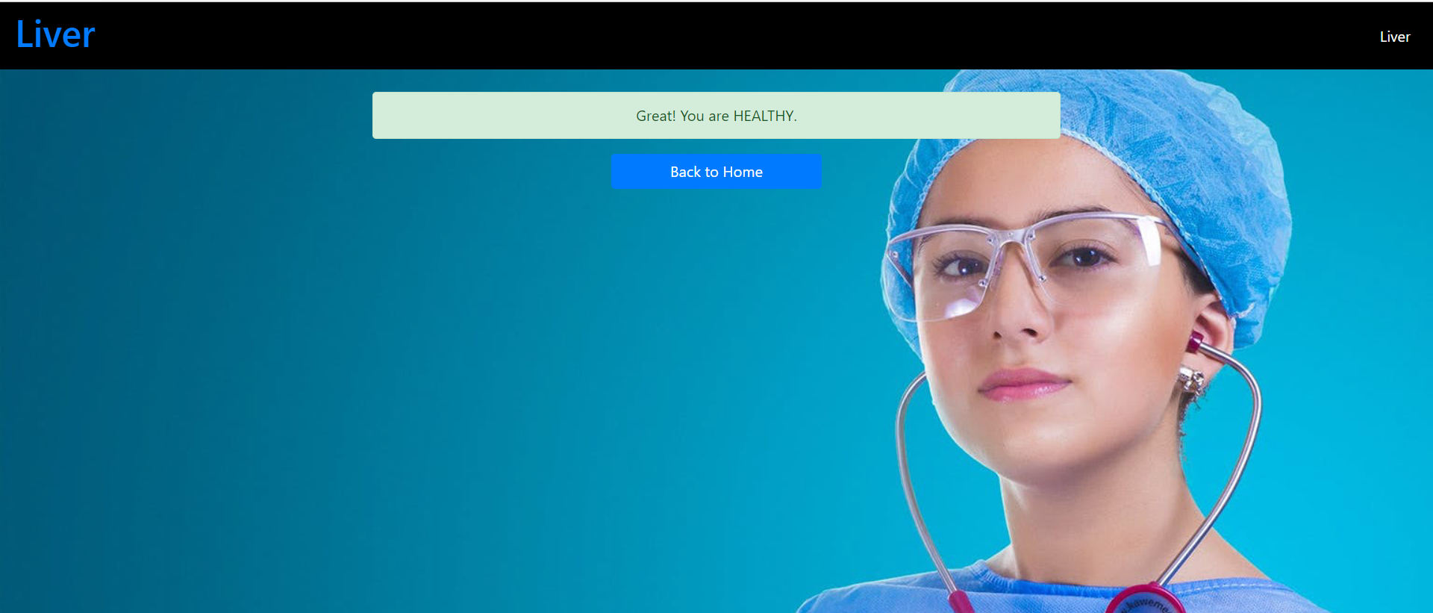

Slide 29
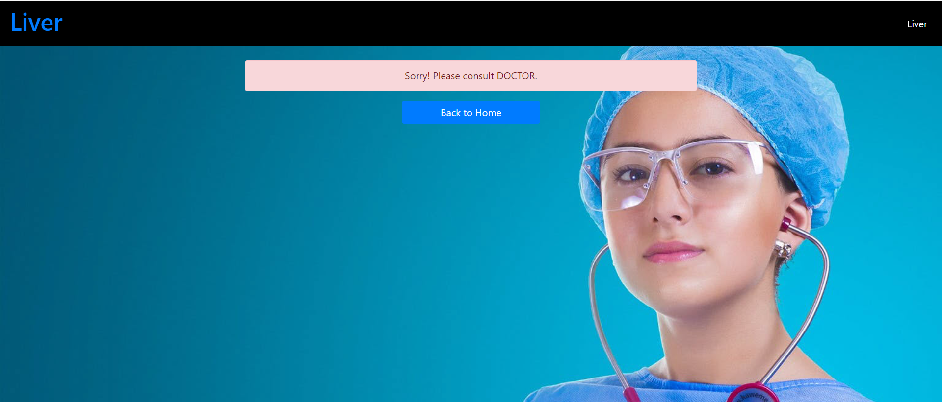

Slide 30
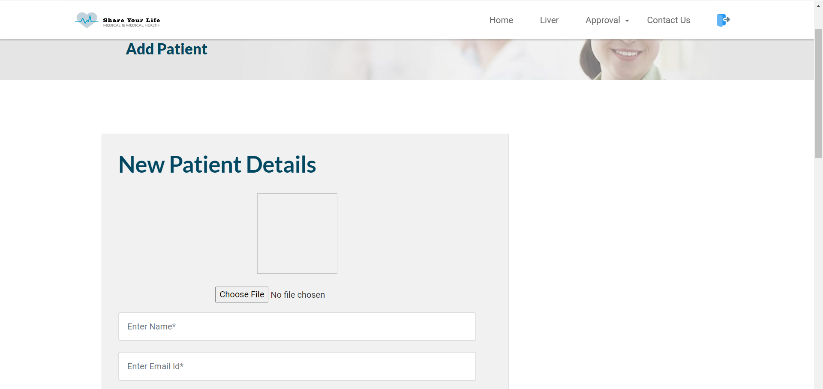
ADD PATIENT BY HOSPITAL

Slide 31
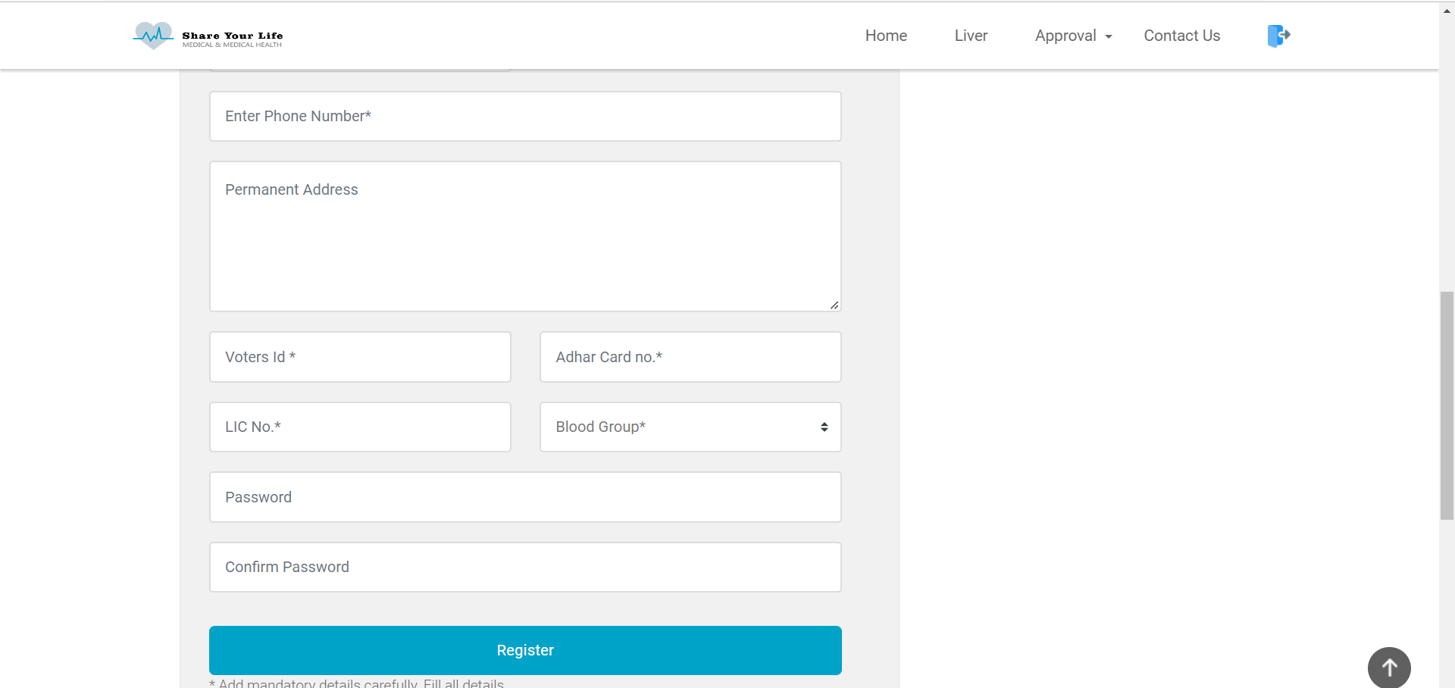

Slide 32
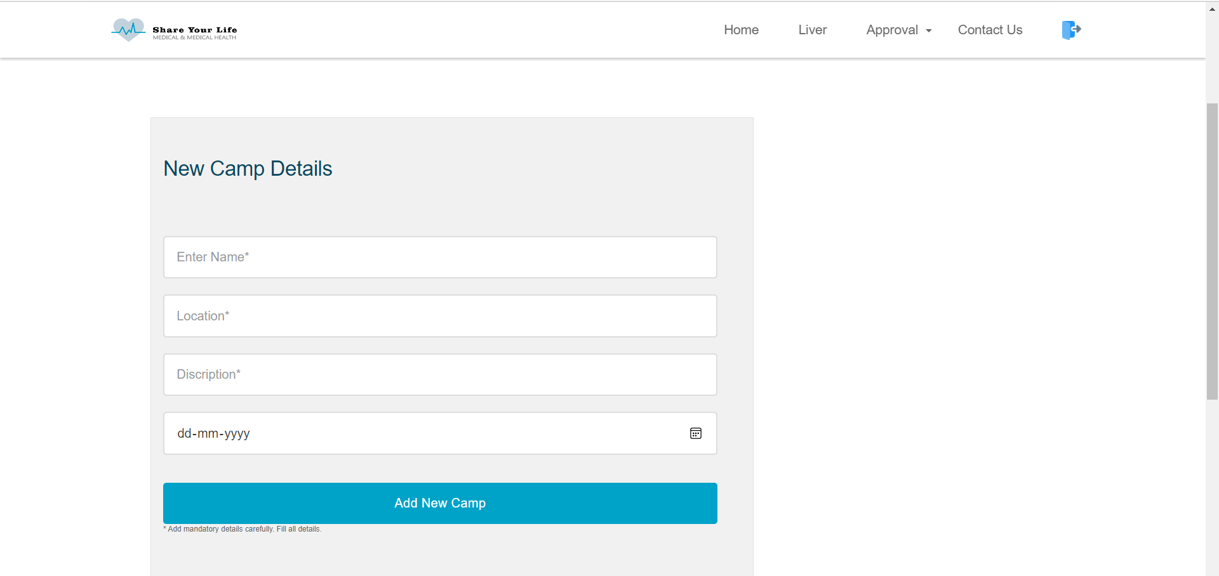
ADD CAMP BY HOSPITAL

Slide 33
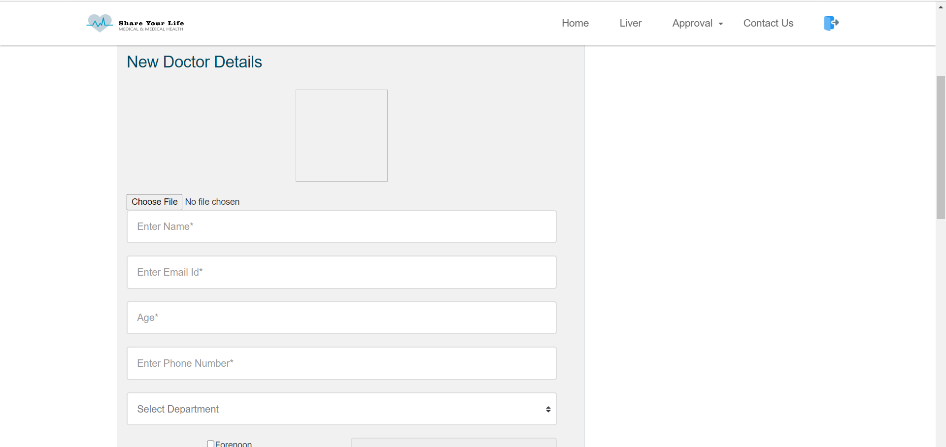
ADD NEW DOCTOR BY HOSPITAL

Slide 34
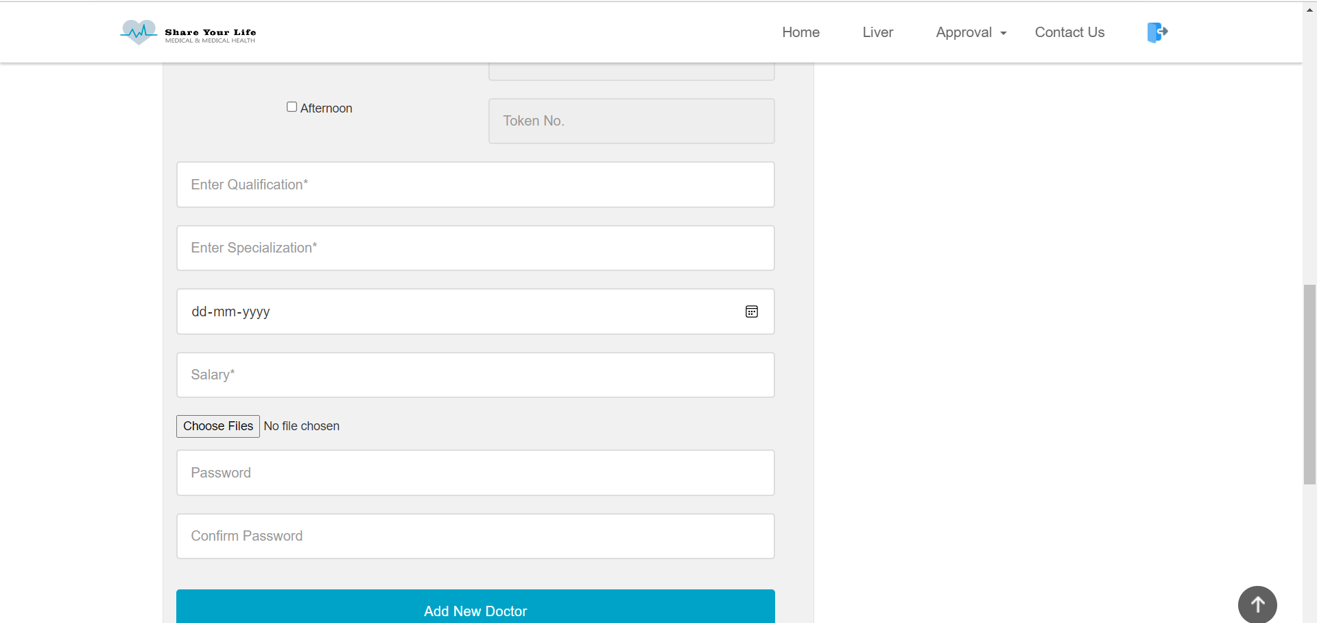

Slide 35
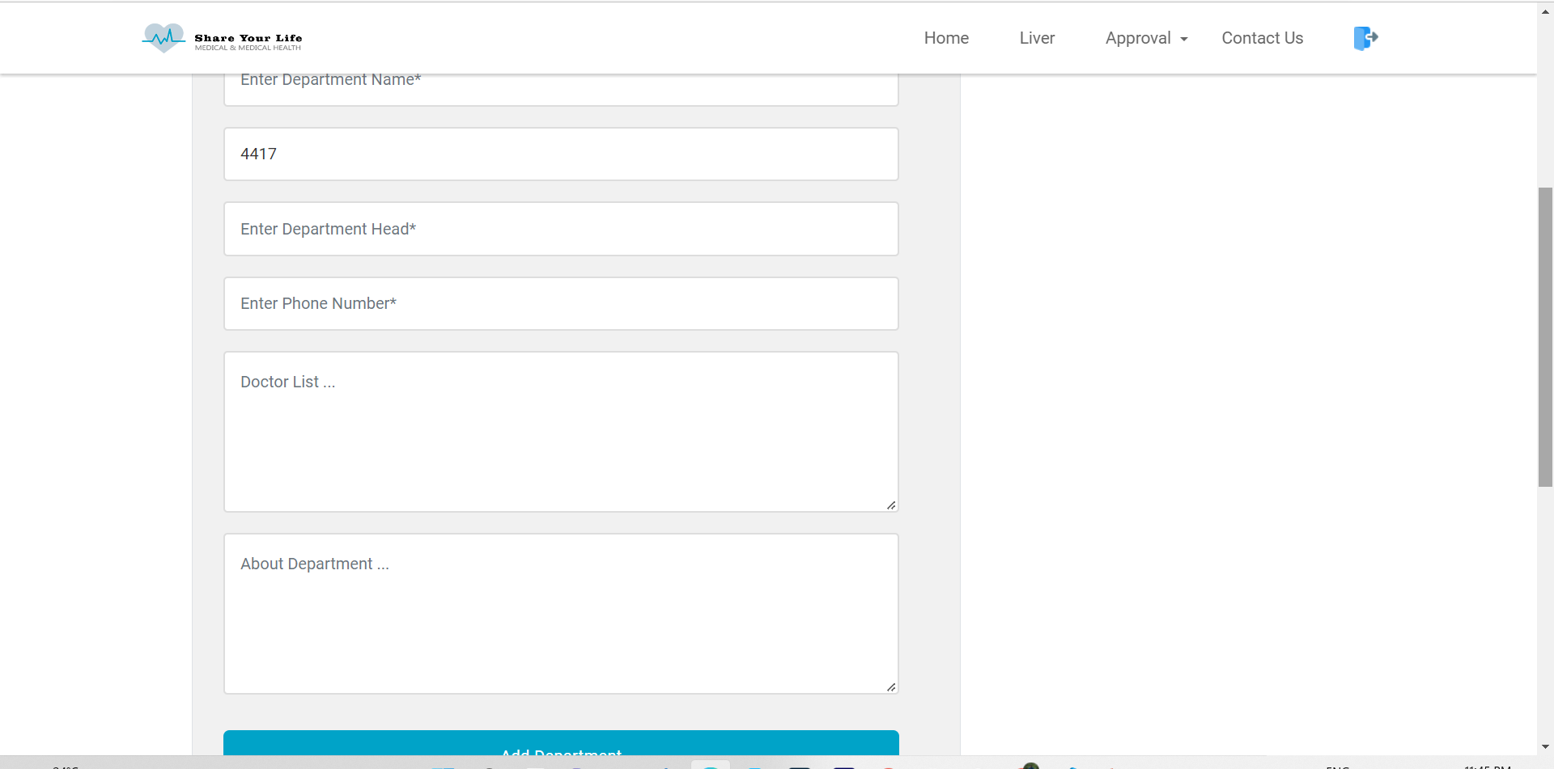
ADD NEW DEPARTMENT BY HOSPITAL

Slide 36
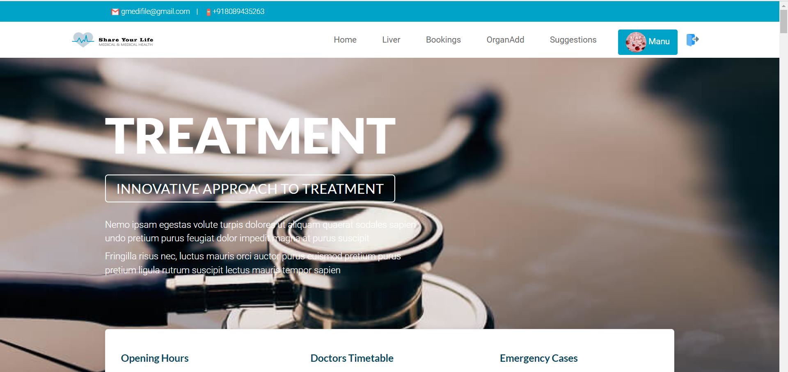
DOCTOR HOME PAGE

Slide 37

LIVER DISEASE PREDCTOR BY DOCTOR

Slide 38
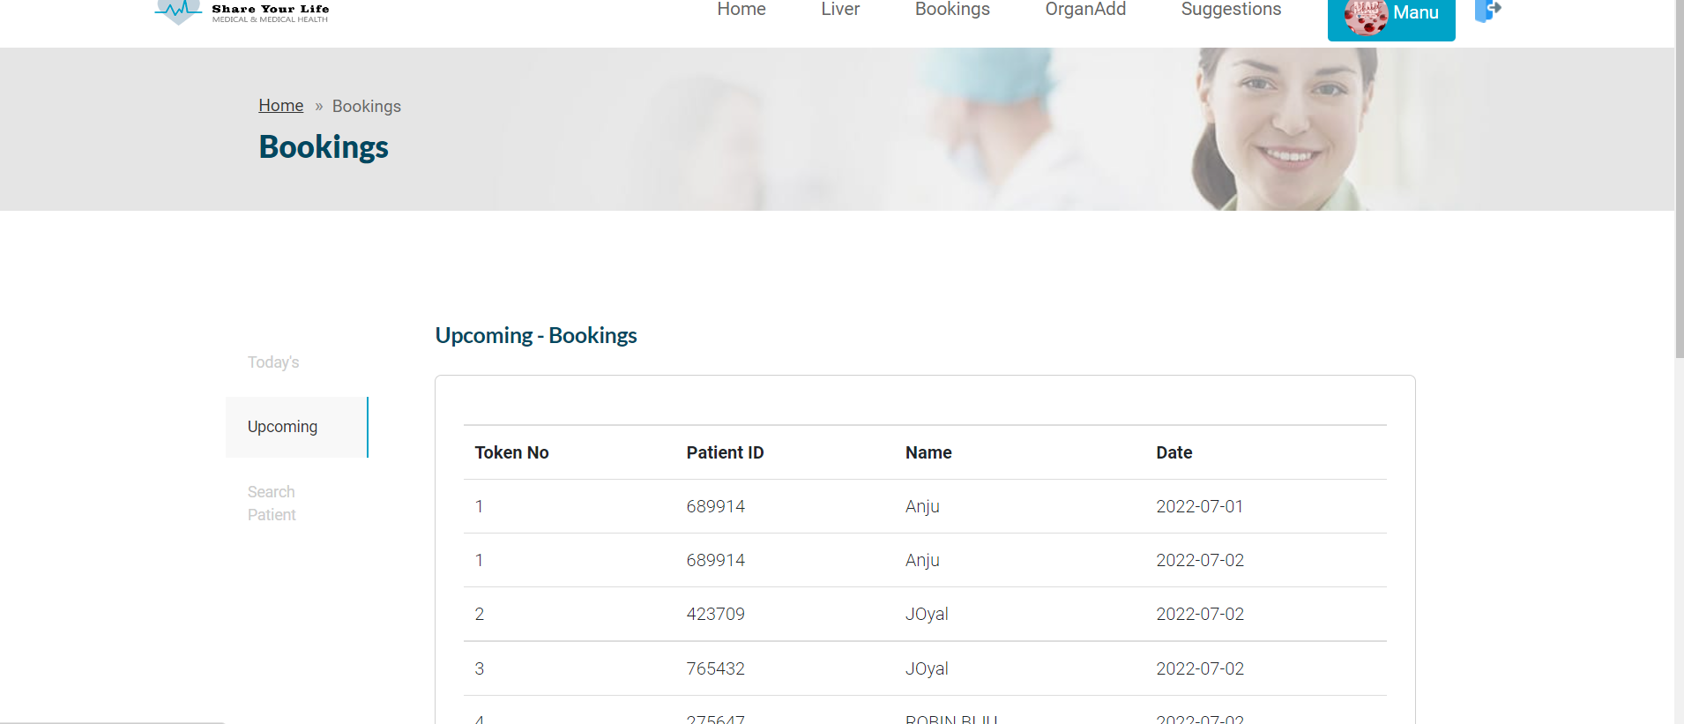
DOCTOR BOOKINGS

Slide 39
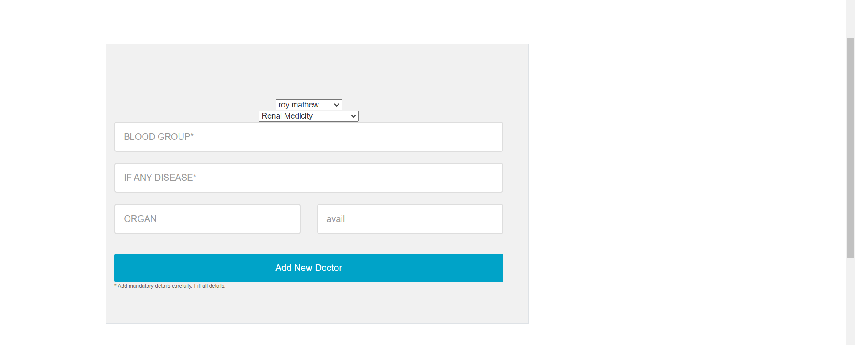
ADD ORGAN DETAILS BY DOCTOR

Slide 40
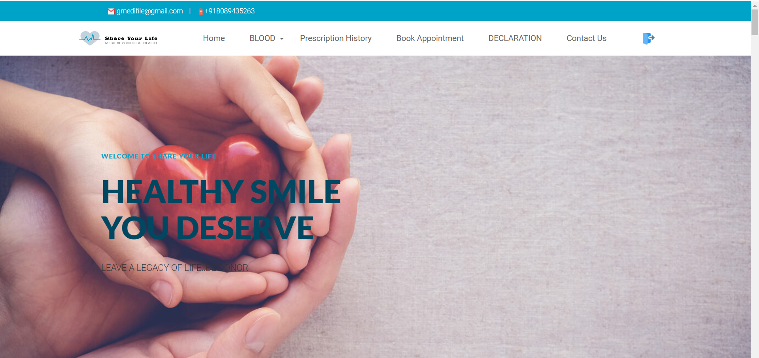
PATIENT HOME PAGE

Slide 41
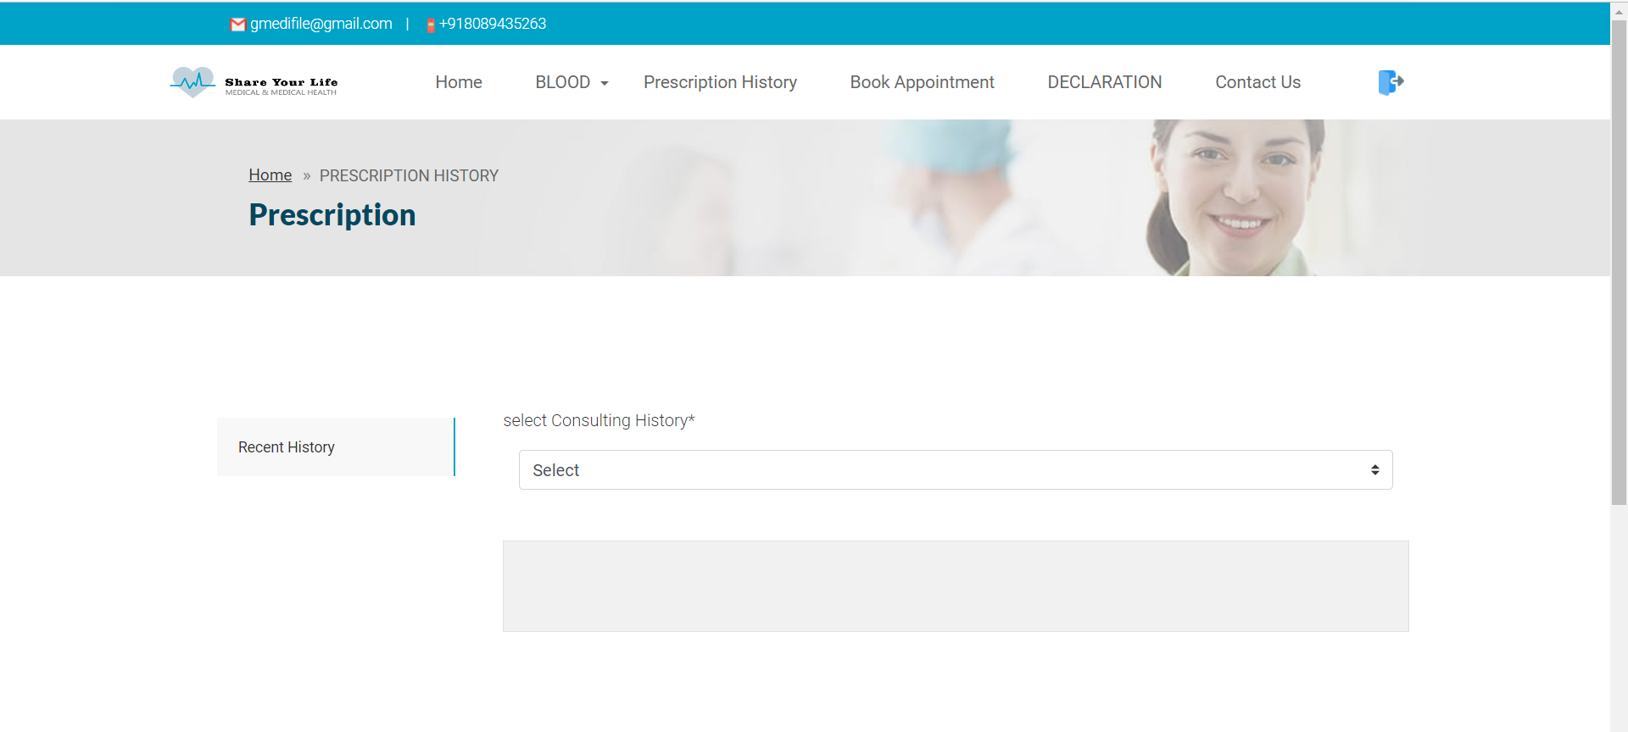
PRESCRIPTION HISTORY

Slide 42
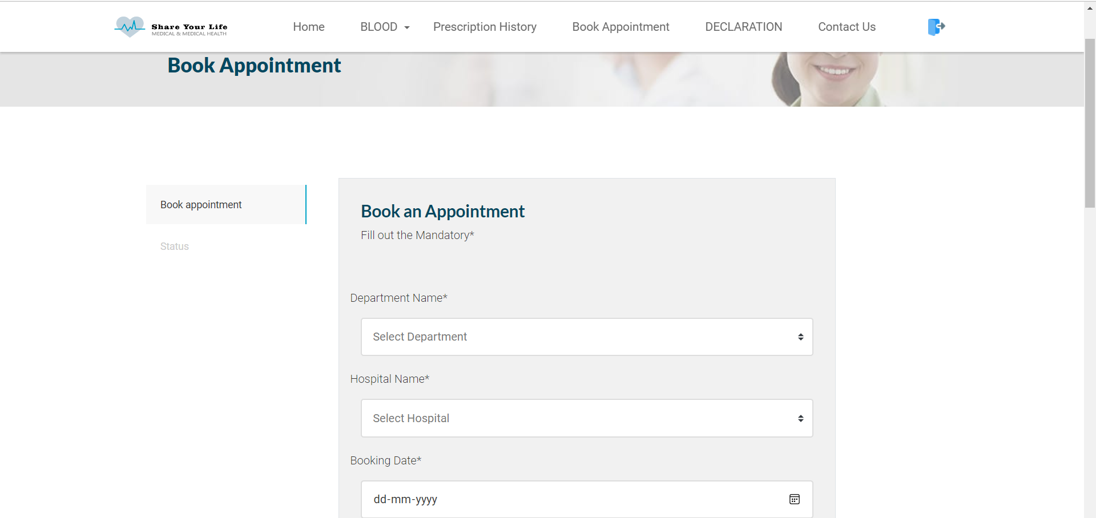
BOOK APPOINTMENT

Slide 43
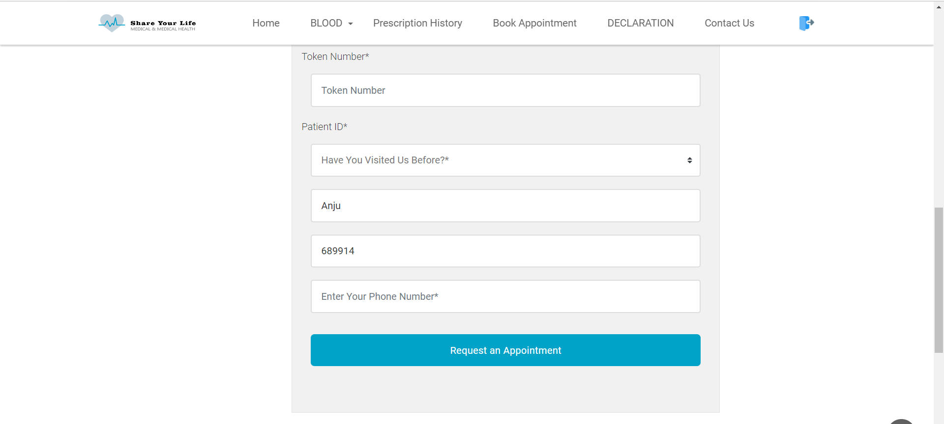

Slide 44
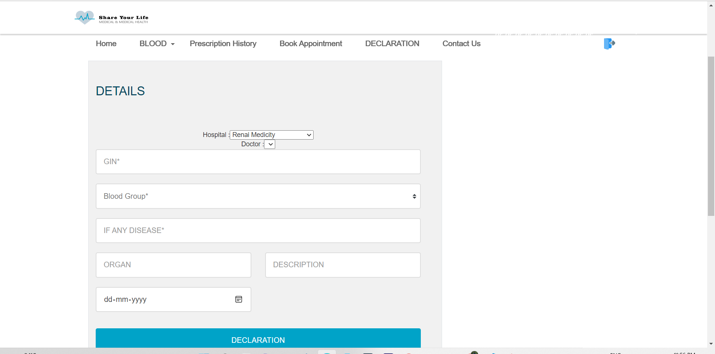
DECLARATION

Slide 45
RESULT ANALYSIS

